Slide 1

Direct Line
Jenna Dorsey, Nishta Patel, Marie Gilbert

Slide 2
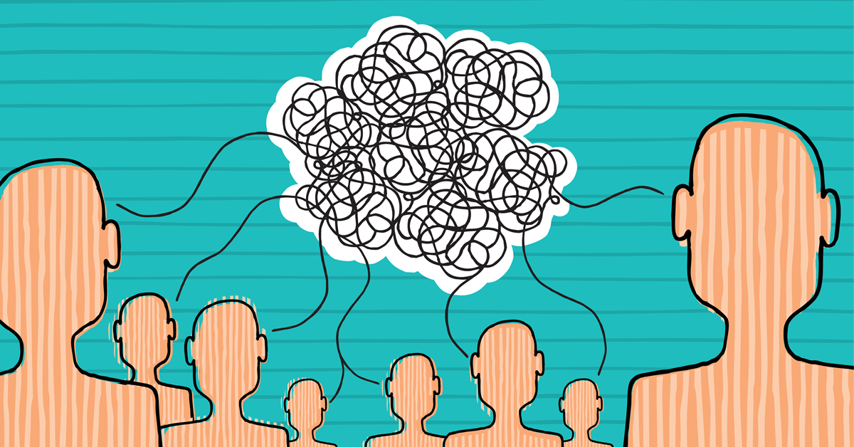
Disconnect

Slide 3
Untimely
Disconnect

Slide 4
Untimely
Disconnect
Privacy

Slide 5
Untimely
Disconnect
Privacy
Link

Slide 6
Untimely
Disconnect
Privacy
Link
Efficient

Slide 7
Untimely
Disconnect
Privacy
Link
Convenience
Efficient

Slide 8
Untimely
Disconnect
Privacy
Link
Convenience
Efficient

Slide 9





Slide 10


